Slide 1
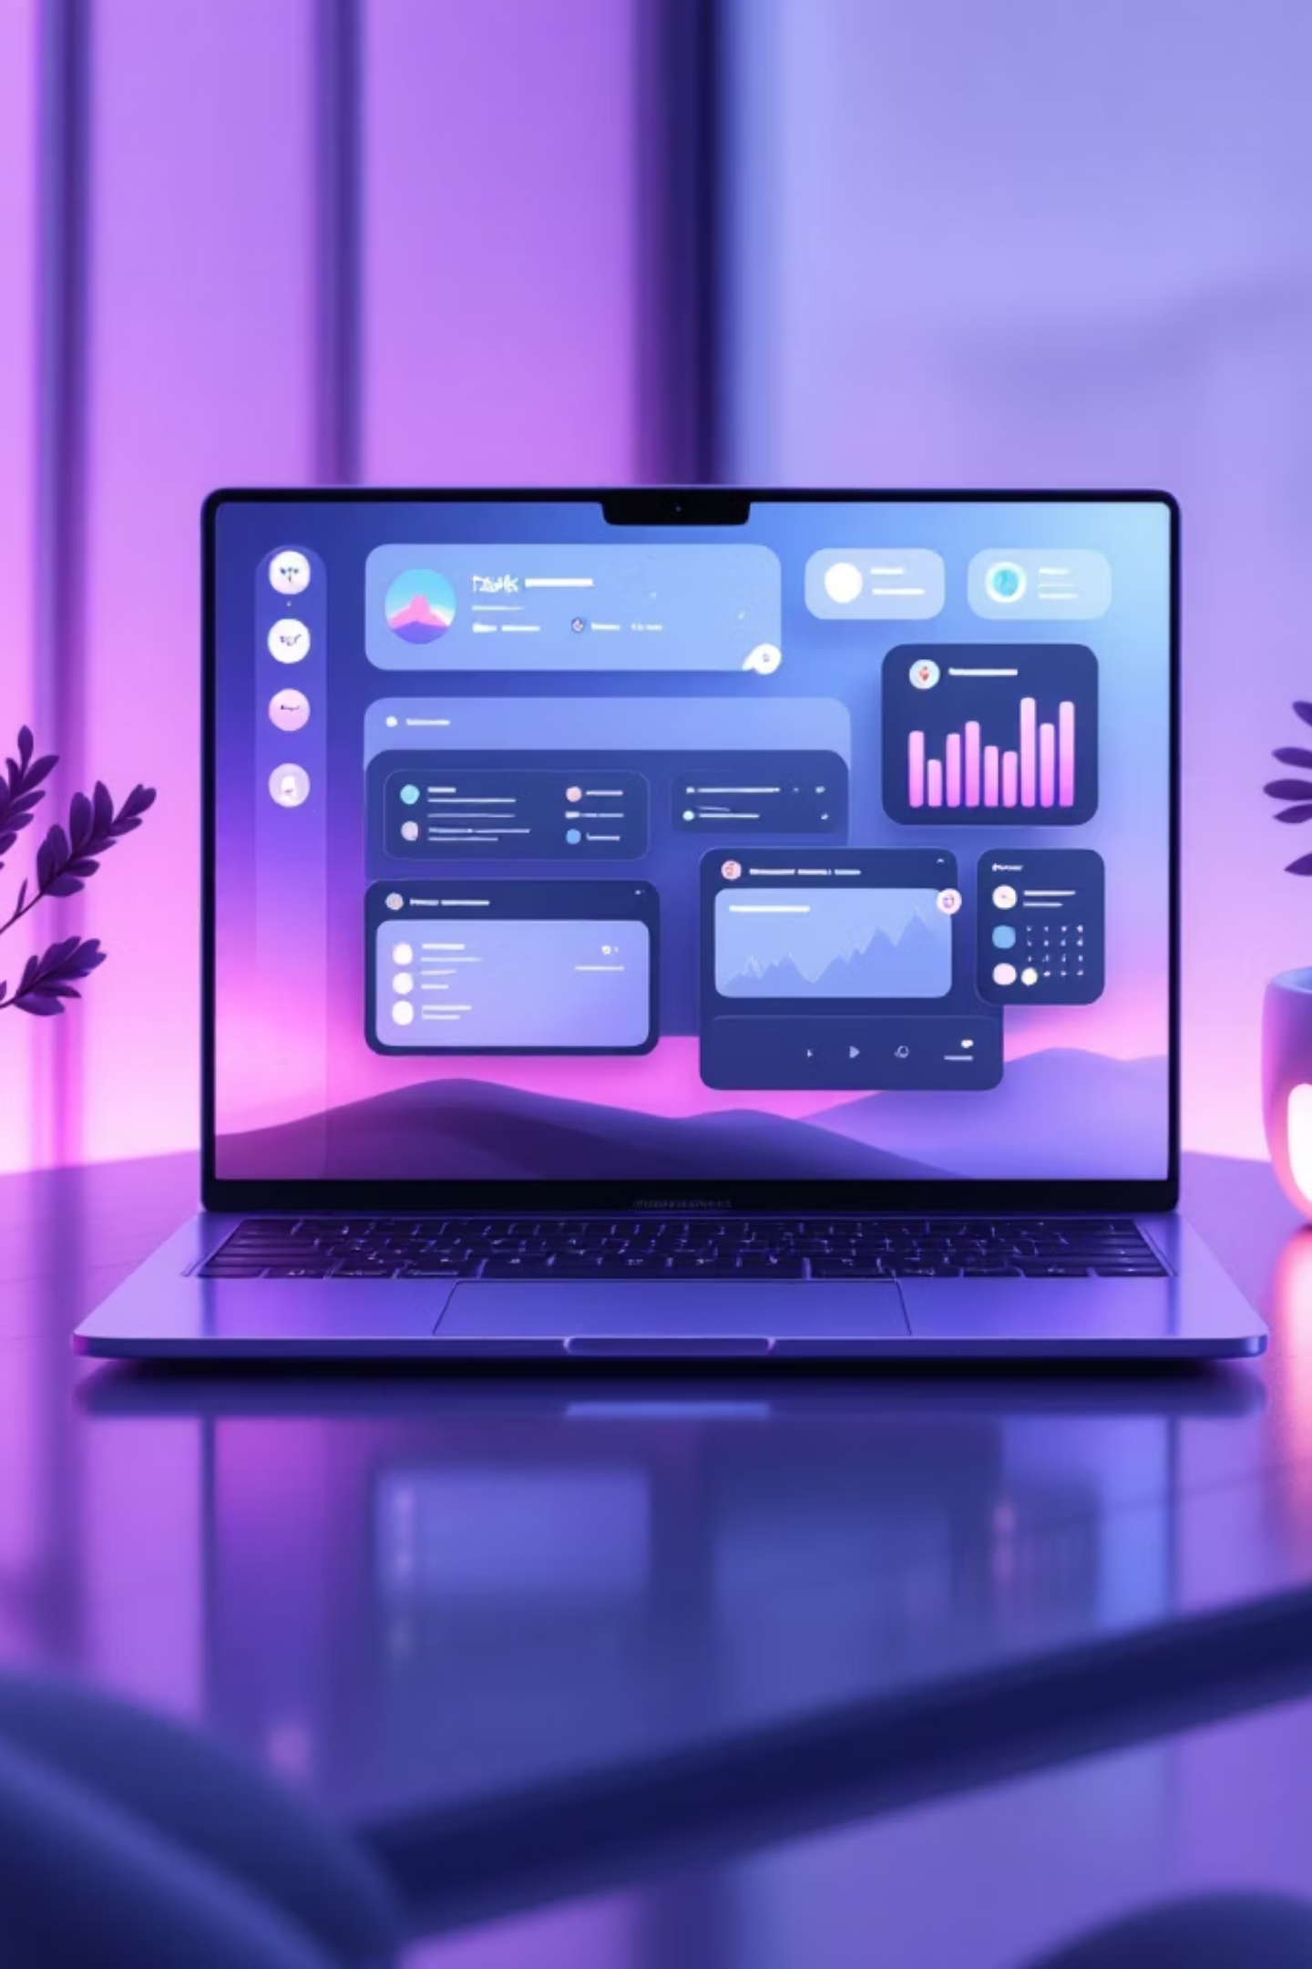
Automated Task Reminder & Tracking Application
People forget daily tasks and deadlines
No proper system to track and manage tasks
Manual tracking leads to missed deadlines
Lack of reminders reduces productivity
Need for an automated solution

Slide 2
Why a Task Reminder is Needed
Stay Organized
Timely Reminders
Saves Time
Helps users keep all tasks in one place and stay on track
Sends reminders before deadlines so users never miss important tasks
Reduces manual effort and improves overall productivity

Slide 3




Project Objectives
1
2
3
Task Management System
Automated Email Reminders
Task Status Tracking
Track task status (Pending, Completed)
Create a system for managing daily tasks
Send automated email reminders to users
4
5
User-Friendly Interface
Time Management
Provide a simple and user-friendly interface
Improve time management for users

Slide 4
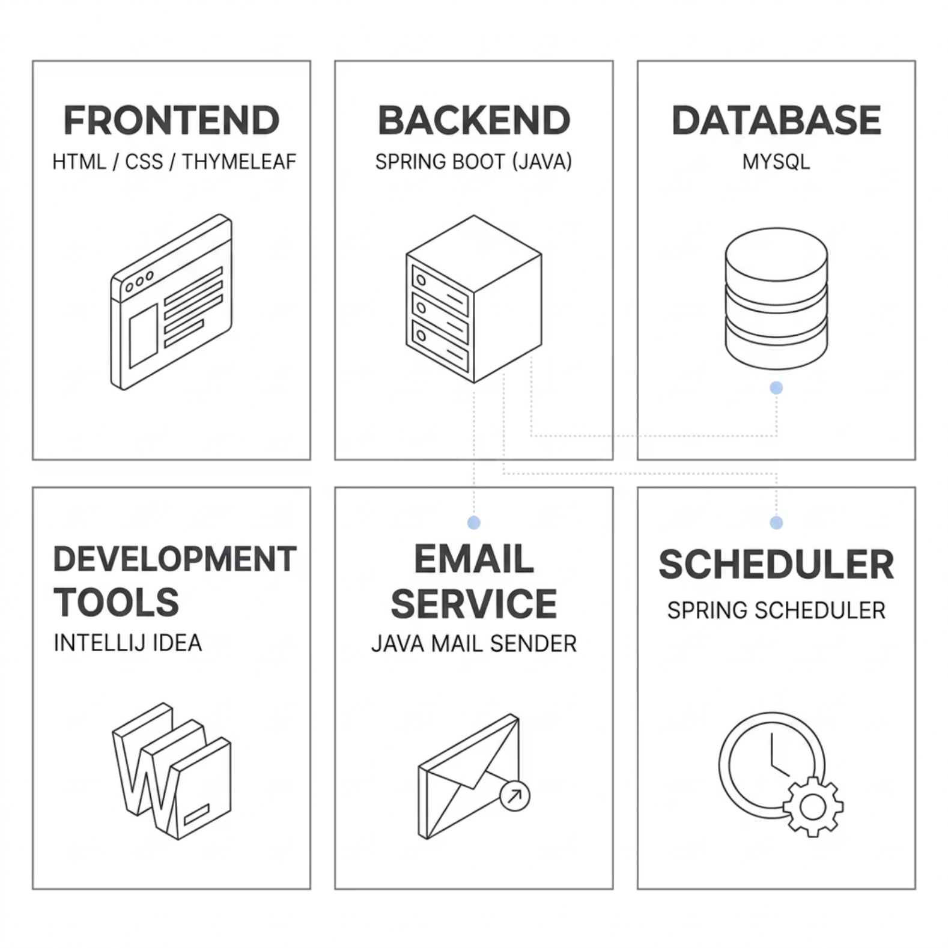

Technologies Used
Backend
Spring Boot (Java) — handles business logic and API layer
Frontend
HTML, CSS, Thymeleaf — renders dynamic web pages
Database
MySQL — stores user and task data
Tools
IntelliJ IDEA — IDE for development
Email Service
Java Mail Sender — sends automated email reminders
Scheduler
Spring Scheduler — runs background task checks

Slide 5
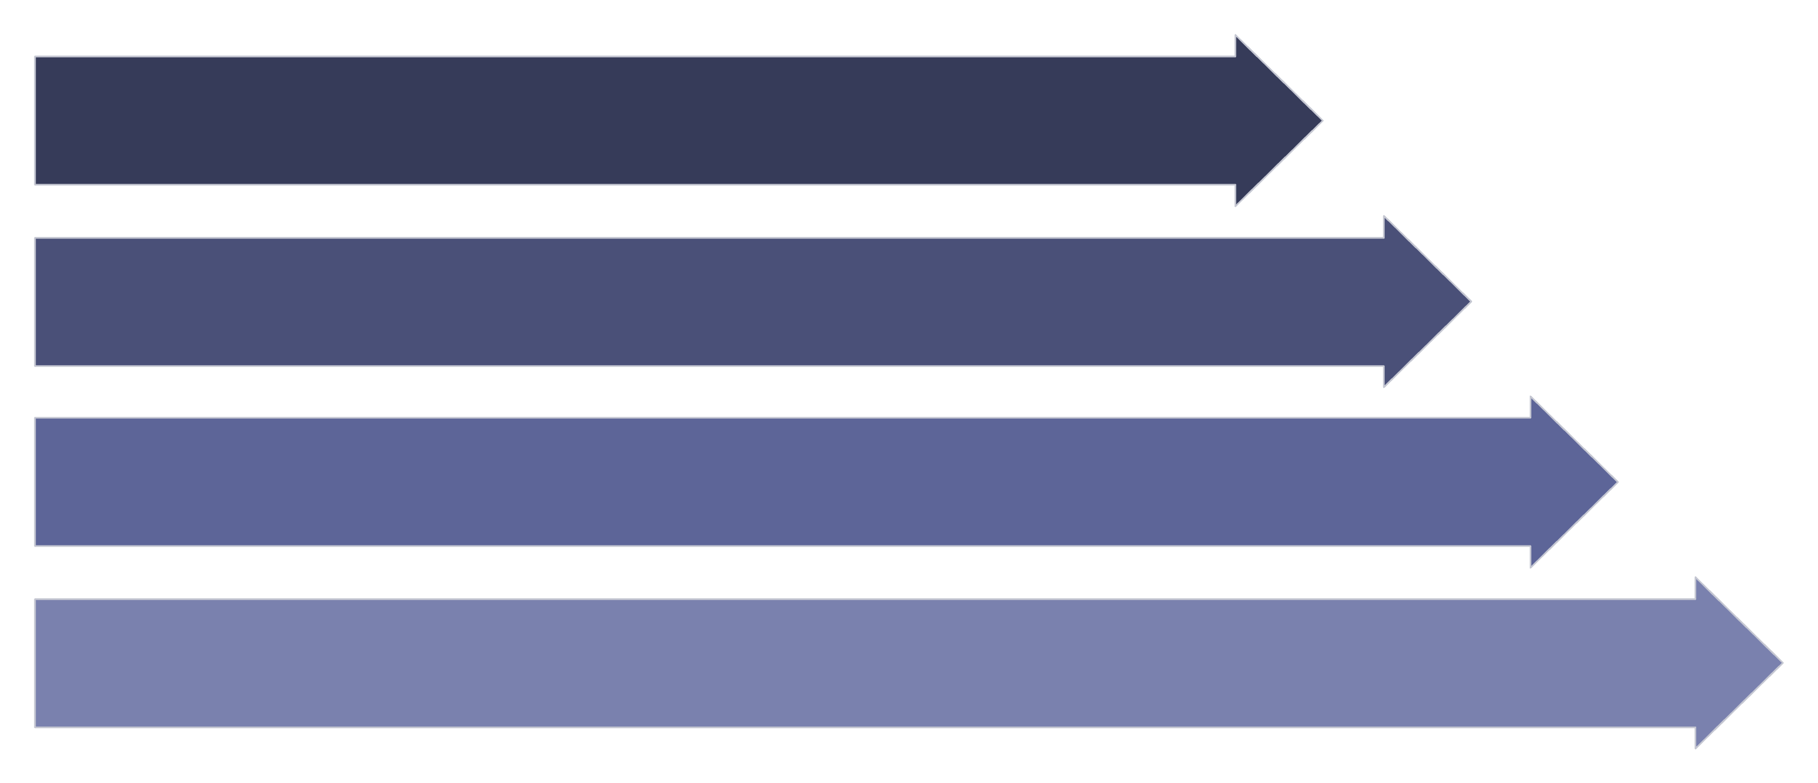
System Architecture
Web App
Authentication
Task Module
Database
The application follows a layered architecture — the user interacts with the web frontend, authentication verifies access, the task module handles all CRUD operations, data is stored in MySQL, and the scheduler triggers email reminders for due tasks.

Slide 6
Module Implementation
Authentication Module
Task Management Module
Dashboard Module
Login and Register pages
Session management
View all tasks
Filter by status
Add, Edit, Delete tasks
Set due dates
Reminder Module
Scheduler Module
Email alerts for due tasks
Configurable timing
Background task processing
Checks due tasks periodically

Slide 7
Key Features
Create, Update, Delete Tasks
Full CRUD operations for managing daily tasks
Email Reminders
Automated alerts sent before task deadlines
Status Tracking
Mark tasks as Pending or Completed
Secure Login
Authentication system protects user data
Simple Dashboard
Clear view of all tasks at a glance

Slide 8


Challenges Faced
Technical Challenges
Handling date and time correctly
Implementing email notification system
Managing backend errors
Connecting frontend with backend
Debugging runtime issues

Slide 9
Future Enhancements
Mobile App Support
Extend the system to Android and iOS platforms
Push Notifications
Real-time alerts directly on the user's device
Calendar Integration
Sync tasks with Google Calendar or similar tools
Multi-User Collaboration
Allow teams to share and assign tasks
Cloud Deployment
Host the application on AWS or similar cloud platforms

Slide 10



Conclusion
Efficient Task Management
Fewer Missed Deadlines
The system helps users manage daily tasks without manual effort
Automated reminders reduce the chances of missing important tasks
Improved Productivity
Practical & Scalable
Better time management leads to higher productivity
Easy to use now, with scope for mobile, cloud, and team features
This project demonstrates a working Spring Boot web application with automated email reminders, task tracking, and a clean user interface — a practical solution for everyday productivity.

